Slide 1


Quick GitHub onboarding steps
STEP 01
STEP 02
STEP 03
STEP 04
STEP 05
Sign in / up for GitHub account
Add and verify Kellogg email to GitHub account
Submit a ServiceNow Ticket to get added to GitHub Enterprise Active Directory Group
Enable 2 Factor Authentication
Set up Teams and Repositories
STEP 01
STEP 02
STEP 03
STEP 04
STEP 05

Slide 2
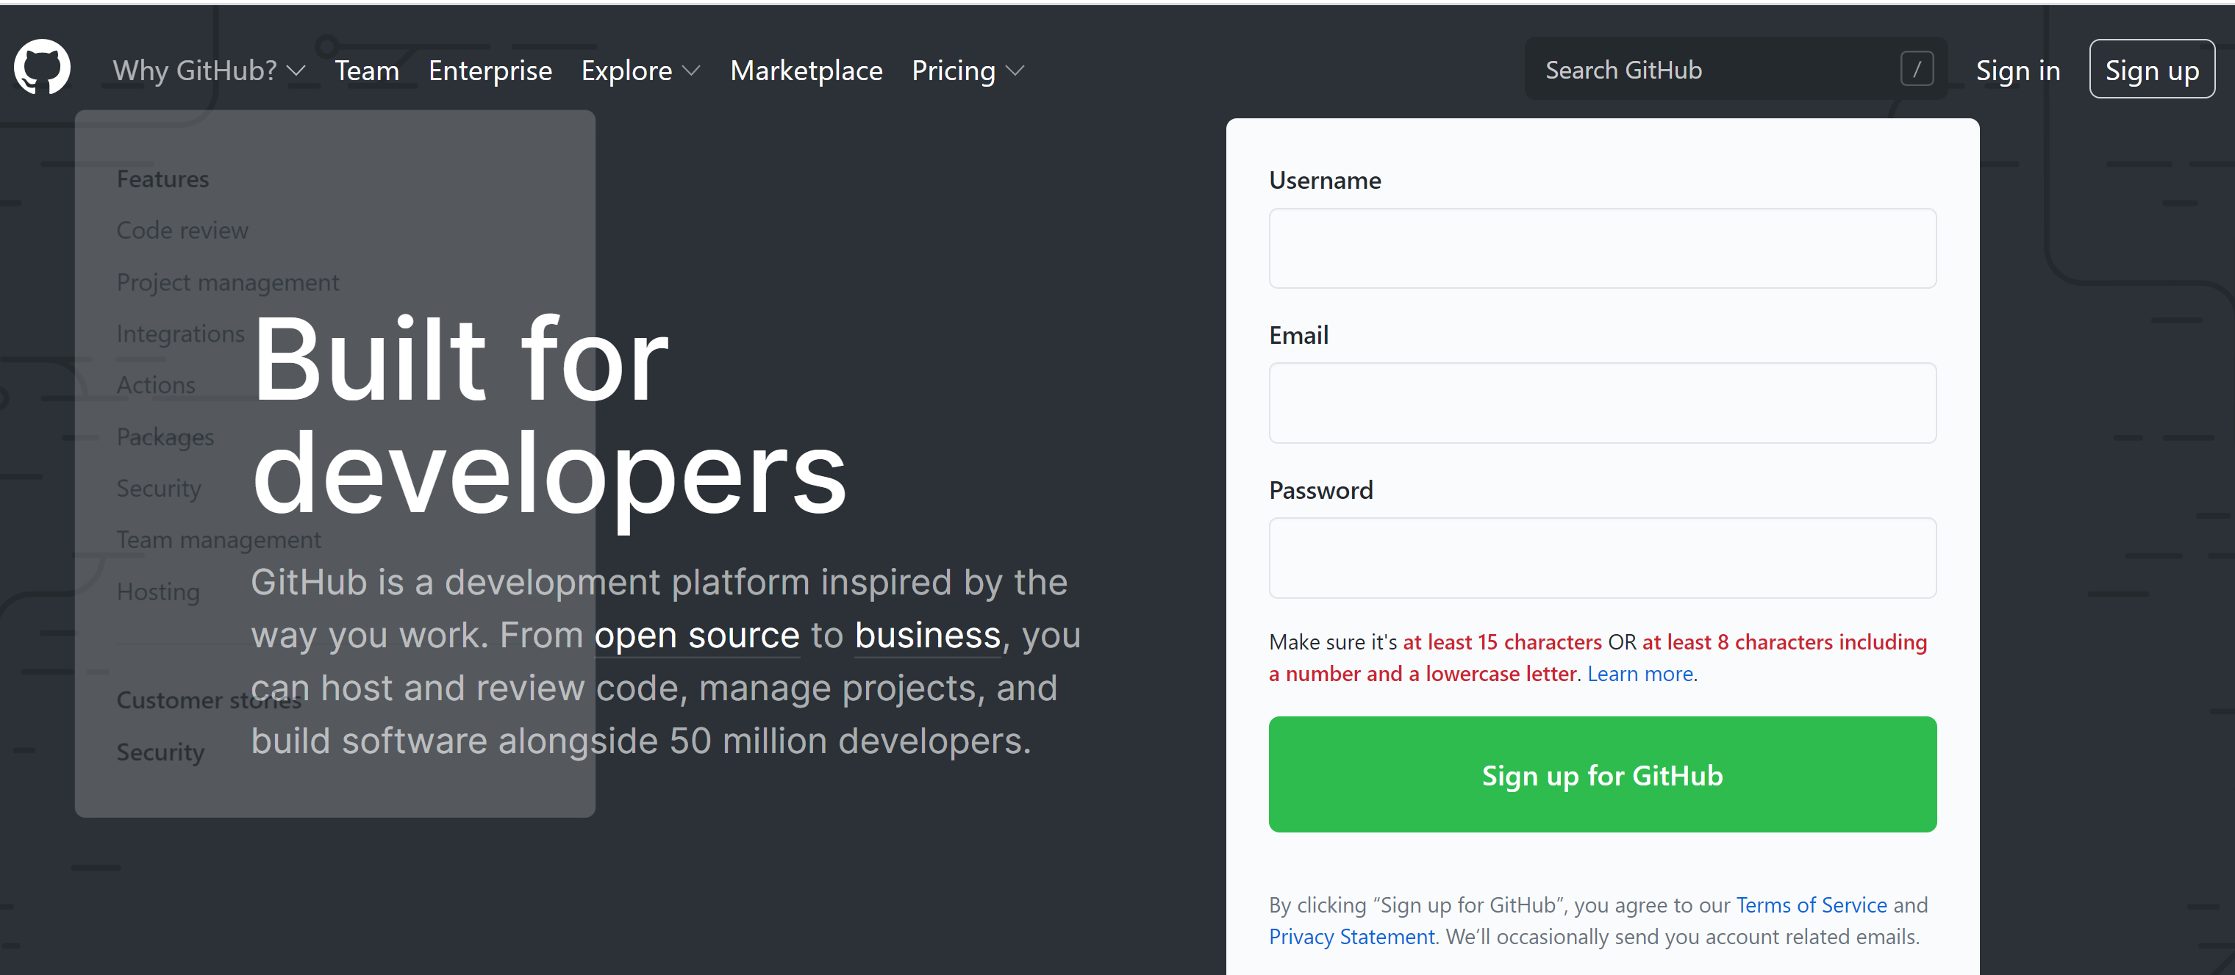
Step 1: sign in to github.com
STEP 01
STEP 02
STEP 03
STEP 04
STEP 05
01
GitHub Site
Go to www.GitHub.com
02
Sign In
If you already have a GitHub.com account with your personal email, sign into your account.

Slide 3
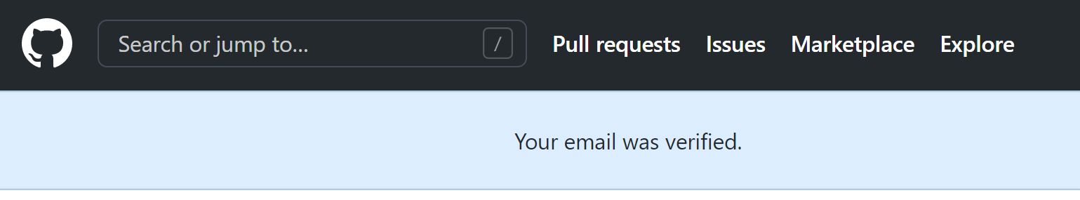



Step 2: verify Kellogg email
STEP 01
STEP 02
STEP 03
STEP 04
STEP 05
1. Verification message
Once you click on the Verification button in your Kellogg email, it will take you back to GitHub and you should see the message “Your email was verified” appear on the main screen.

